Slide 1
Design of a Nuclear Reactor
Jay Hopkins
IAEA
J.Hopkins@iaea.org

Slide 2
Learning objectives
After completing this chapter, the trainee will be able to:
List basic components of nuclear reactors.
List basic types of nuclear power plants / research reactors.
List the levels of defence in the design of nuclear installation.
List and briefly describe main requirements for plant design.

Slide 3
Contents
Types of Nuclear Reactors
Design and type of research reactors
Basic concept in design
Basic safety features of the design
Design of nuclear power plant systems
Safety guidance for research reactor design

Slide 4
Types of Nuclear Reactors
J. Hopkins
IAEA
J.Hopkins@iaea.org

Slide 5
Basic components of a nuclear reactor (1/3)
A nuclear power plant can be basically divided to:
  a nuclear part and
  a conventional part;
In the nuclear part the fission energy is converted into heat which is used to produce steam. Its main component is nuclear reactor.
Notes:
(Second bullet) The nuclear part is also called Nuclear Steam Supply System (NSSS). In nuclear reactor the nuclear fission chain reaction takes place. Reactor contains nuclear fuel, which is made of uranium (sometimes mixed with plutonium).

Slide 6
Basic components of a nuclear reactor (2/3)
In the conventional part this steam runs the turbine connected to generator.
A reactor must have means to slow down neutrons.
  Moderator
  → ordinary water
  → heavy water
  → graphite
Notes:
(First bullet) The conventional part of a nuclear power plant is very similar to a conventional thermal power plant from the boiler onwards.
(Second bullet) Moderator: a material made of light elements.
The most usual moderator is ordinary water, called also light water (H₂O).
Heavy water is more efficient moderator than light water, because it almost doesn’t absorb any neutrons in the process of their slowing down. A reactor with heavy water can use natural uranium as fuel, while light water requires enriched uranium.
Similarly to heavy water, also graphite-moderated reactors can use natural uranium fuel. In fact, the first nuclear reactor, built by Enrico Fermi in 1942, used graphite as moderator.

Slide 7
Basic components of a nuclear reactor (3/3)
Nuclear reactions produce large quantities of heat which must be transferred out of the fuel.
  Reactor coolant.
The coolant has to be in liquid or gaseous form and should not absorb neutrons substantially.
Control system is used to start-up the reactor, to shut it down, and to adjust the reactor power level. Contains materials that are strong neutron absorbers.
Notes:
(First bullet) This is the role of reactor coolant.
(Second bullet) In many cases reactor coolant and moderator are the same substance, but this is not necessary. In particular, graphite-moderated reactors are cooled with gas (CO₂, He) or light water.
(Third bullet) Each reactor has also control system, which is used to start-up the reactor, to shut it down, and to adjust the reactor power level. The control system contains materials that are strong neutron absorbers (boron, indium, cadmium…).

Slide 8
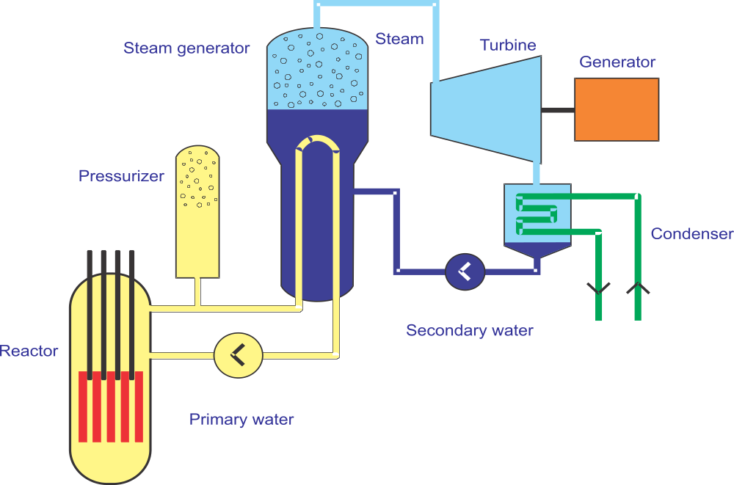
Pressurized Water Reactor – PWR (1/3)
Pressurized Water Reactor – PWR
Moderated and cooled with ordinary water. The pressure in the reactor is so high that the water does not boil. The heat is transferred to secondary side in the steam generator. The steam produced there drives the turbine.
Notes:
The heat from primary water is transferred to secondary water in steam generators. In the steam generators (SG), secondary water is converted into steam which drives the turbine.

Slide 9
Pressurized Water Reactor – PWR (2/3)
A significant majority of nuclear power plants is cooled by ordinary water.
  Water is in liquid state → temperature is always below 375 °C;
The first and still the most common type of light water reactor is Pressurized Water Reactor.
  Pressure is typically around 15.5 MPa (155 bar).
Notes:
(First bullet) The main advantage of water is that it is cheap and that there is extensive experience with using it as a working medium in conventional thermal power plants. Usually water is used as moderator, as well.
Therefore it must be in liquid state at least in the surroundings of fuel, because water vapour is less efficient in moderating neutrons and also as in heat transfer. At standard atmospheric pressure water boils at 100 °C, therefore the pressure in the reactor should be higher if higher temperature is desired (in order to achieve higher thermodynamic efficiency).
Water exists as liquid only below it critical temperature of 375 °C. Therefore the coolant temperature in Light Water Reactors (LWR) is always below the critical temperature of water.
(Second bullet) Its main feature is that the pressure is so high that the water does not boil in the reactor.
The highest temperature (at this pressure) of so-called primary water is around 330 °C.

Slide 10
Pressurized Water Reactor – PWR (3/3)
The fuel is:
  slightly enriched uranium (3 – 5%);
Main advantage of PWRs
  radioactive coolant is effectively separated from the environment;
PWR technology
  proved to be reliable and cost effective;
Notes:
(second bullet) The main advantage of PWRs is that the primary, radioactive coolant is effectively separated from the environment with the intermediate, secondary system. On the other hand, this intermediate system means more components, more possible failures and a higher cost. There have been several problems with steam generator vibrations and leaks in the past.
(Third bullet) The PWR technology proved to be reliable and cost effective. Today around 62 % of all operating NPPs are of this type (53% PWR and 9% VVER).

Slide 11
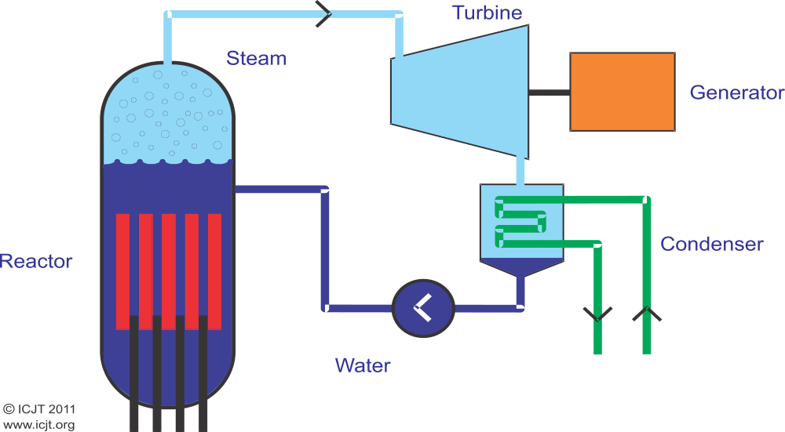
Boiling Water Reactor – BWR (1/2)
Boiling Water Reactor - BWR
Moderated and cooled with ordinary water. Water boils in the reactor and the resulting steam drives the turbine.
Notes:
In a BWR water boils already in reactor and the steam produced, with temperature around 290 °C, is directly led to turbine. Contrary to PWR.

Slide 12
Boiling Water Reactor – BWR (2/2)
Pressure in the reactor vessel
  half of the pressure in a PWR;
The fuel → similar to PWR fuel;
  The advantage of boiling water reactor is relatively simple design.
  Disadvantage → contaminated with radioactive substances
  turbine, condenser and other steam system parts;
Notes:
(First bullet) Boiling water reactors are the second most common type of reactors.
(Second bullet) The pressure in the reactor vessel is about half of the pressure in a PWR, consequently its walls are thinner (around 15 cm).
(Third bullet) The fuel is in several aspects similar to PWR fuel.
(Fifth bullet) Disadvantage is that the turbine, the condenser and other steam system parts are contaminated with radioactive substances.
(Sixth bullet) The cost of some other components is higher and the end result is that the total investment and the operating costs are very much comparable with those of PWR. After PWRs – around 19 % of reactors in the world are BWRs. The Fukushima Daiichi nuclear power plant had 6 units, all of them BWR.

Slide 13
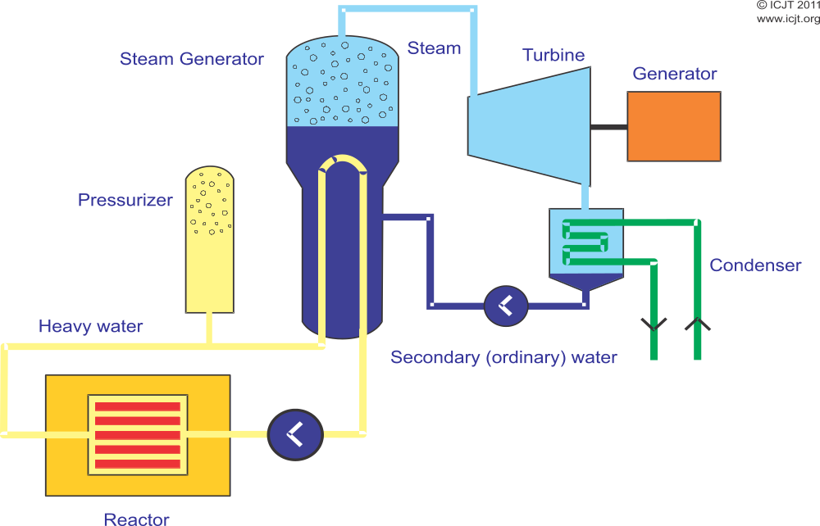
Pressurized Heavy Water Reactor – PHWR (1/2)
Pressurized Heavy Water Reactor – PHWR
Moderated and cooled with heavy water. Water does not boil in the reactor. Heavy water transfers its heat to light water in the steam generators, the resulting steam drives the turbine.
Notes:
Besides Canada, CANDU reactors are in India, Pakistan, Argentina, South Korea, Romania and China.
Their share is 11% of all reactors in the world.

Slide 14
Pressurized Heavy Water Reactor – PHWR (2/2)
Fuel made of natural uranium
  inside a large number of pressure tubes,
  coolant (heavy water) under pressure flows through;
The main advantage of CANDU reactors is the possibility to use slightly enriched natural uranium.
The disadvantage:
  expensive production of heavy water,
  lower thermal efficiency;
Notes:
(Additional text) The design of two German-made heavy-water reactors in Argentina has some similarities with light-water PWRs.
(First bullet) Fuel made of natural uranium is inside a large number of pressure tubes, where coolant (heavy water) under pressure flows through. A set of these tubes is called calandria and is placed inside a large tank of heavy water which is not pressurized and acts as moderator. This design enables fuel to be replaced on-line, i.e., during operation of reactor.
(Second bullet) But with availability of enriched uranium it turns out, that the most economical operation is achieved by using slightly enriched (around 1%) uranium.
(Third bullet) The disadvantage of heavy water reactors is expensive production of heavy water and replacement of its losses, relatively complex regulation system and lower thermal efficiency (up to 30%).

Slide 15
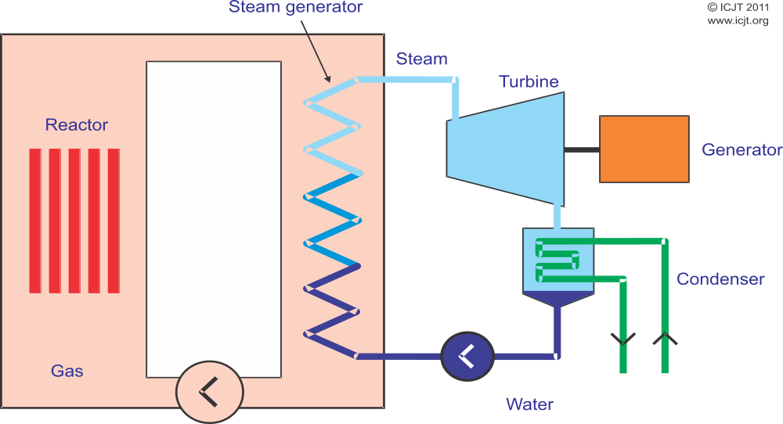
Gas Cooled Reactor – GCR, AGR, HTGR (1/2)
Gas Cooled Reactor – GCR, Advanced Gas-cooled Reactor – AGR
Moderator is graphite, coolant is gas which in the steam generator transfers its heat to water. The resulting steam drives the turbine.
Notes:
Their share is 3% of all reactors in the world.

Slide 16
Gas Cooled Reactor – GCR, AGR, HTGR (2/2)
Natural uranium can be used;
GCR → a type of reactors which are cooled with CO₂ at temperature around 400 °C.
An improved version → AGR uses slightly enriched uranium in stainless steel cladding which allows CO₂ temperatures up to 650 °C.
The advantage of gas cooled reactors is:
  high thermal efficiency.
Notes:
(First bullet) Natural uranium can be used as fuel also in graphite-moderated reactors. Naturally, such reactors require some other medium as the coolant.
(Second bullet) United Kingdom developed a type of reactors called GCR which were cooled with CO₂ at temperature around 400 °C. They are also known as Magnox reactors, because their fuel cladding is made of a magnesium alloy.
(Third bullet) AGR - Advanced Gas-cooled Reactor
(Fourth bullet) High thermal efficiency in principle means that less fuel is consumed for a given production of electricity.
(Additional text) United States built two reactors HTGR (High Temperature Gas-cooled Reactor), cooled with helium at temperature of 750 °C, and the fuel was a mixture of enriched uranium and thorium.
(Additional text) Today gas cooled reactors only operate in United Kingdom (3 % of all NPP in the world), but even the British changed to PWRs.

Slide 17
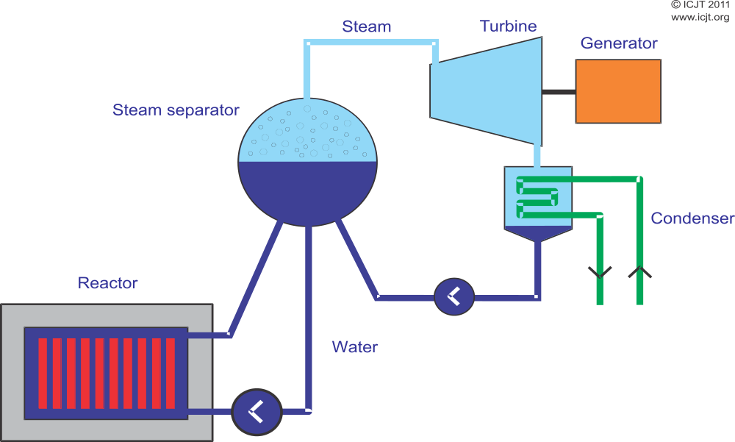
Light Water Graphite moderated Reactor – LWGR (1/2)
Light Water Graphite moderated Reactor – LWGR
The moderator is graphite and the coolant is water that boils in pressure tubes around the fuel.
Notes:
In 1986, one of this type of reactors in Chernobyl (nowadays Ukraine) suffered the worst nuclear accident ever.
In the RBMK reactor, water boils in pressure tubes that encompass fuel rods. The fuel is uranium enriched to around 2 %. Pressure tubes are distributed in a large graphite structure which acts as moderator. Steam that is produced in the fuel area, is collected in large vessels, steam separators. The reactor core is quite large and has a complex control system. There is no containment. Refuelling can be made during operation of reactor.

Slide 18
Light Water Graphite moderated Reactor – LWGR (2/2)
Graphite moderated reactors can be cooled also with water.
An important feature of RBMK reactors is that they are unstable at low power.
This was, besides lack of safety culture, the main cause for the accident that happened in Chernobyl on April 26, 1986. After the accident, there were several modifications in the remaining RBMK reactors.
Notes:
(Second bullet) Former Soviet Union produced such reactors called RBMK (Reaktor Bolshoy Moshchnosti Kanalniy – High Power Channel Reactor).
(Fourth bullet) In order to improve their safety but nevertheless new reactors of this type are not built anymore.
(Fifth bullet) They are all in Russia.

Slide 19
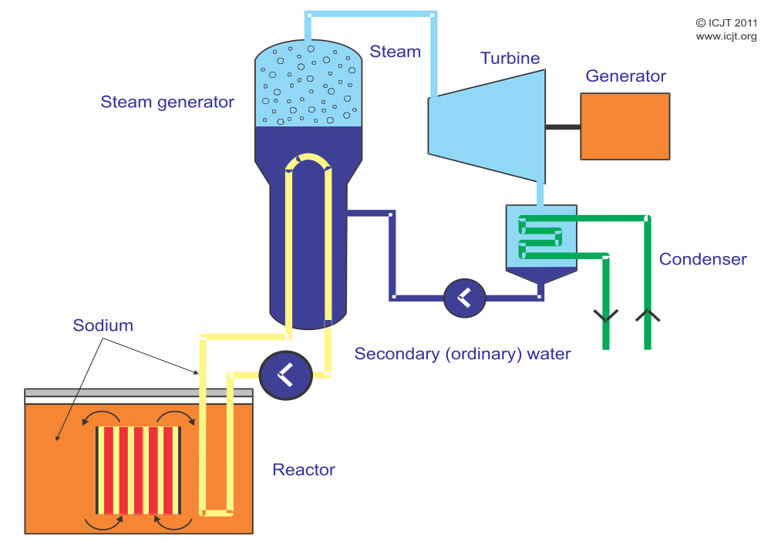
Fast Breeder Reactor – FBR (1/2)
Fast Breeder Reactor – FBR
There is no moderator. The primary and the secondary coolant is liquid metal, usually sodium. The secondary coolant transfers its heat to water in steam generators. The resulting steam drives the turbine.
Notes:
(Description) Fast reactor fuel is 10-30% enriched uranium or is mixed with 10-30% of plutonium. There is no moderator and also the coolant is made of material that does not slow down the neutrons. The majority of fast reactors is cooled with liquid sodium. The boiling point of sodium is quite high, therefore the coolant can be under normal pressure and pressure vessel is not necessary. Because sodium becomes very radioactive, its heat is transferred to a secondary (non-radioactive) sodium loop which in the steam generator heats water. The resulting steam drives the turbine.

Slide 20
Fast Breeder Reactor – FBR (2/2)
An important feature of fast neutron-induced fission is that a higher number of new neutrons is born.
To sustain the chain reaction, on average one neutron born in fission is required.
The majority of the neutrons can be absorbed in non-fissile isotope of uranium, ²³⁸U.
This absorption reaction leads to production of artificial element plutonium.
Notes:
(First bullet) In all reactors described so far the chain reaction was maintained by slow, so called thermal neutrons. Fast neutrons - born immediately after fission. The underlying technology is more demanding than for thermal fission chain reaction.
(Second bullet) Compared to thermal neutron-induced fission.
(Fourth bullet) Some of the remaining neutrons leak out of the reactor, some are absorbed in various construction materials.
(Fifth bullet) Plutonium is fissile and can be used as nuclear fuel.
(Additional text to fifth bullet)
Fast reactors are therefore also often called breeder reactors.
Paradox can be explained with the fact that breeder reactors produce fuel from normally non-fissile ²³⁸U.
In principle, fast breeder reactors could therefore cover world electricity demand for several thousand years.

Slide 21
Small and Medium Reactors – SMR (1/2)
Reactor classification
  small reactors [an equivalent electric power of less than 300 MW(e)],
  medium sized [between 300 and 700 MW(e)].
Worldwide, 131 Small and Medium Reactors (SMR) are in operation in 26 Member States, with a capacity of 59 Gwe.
Notes:
(First bullet) According to the classification adopted by the IAEA.
(Second bullet/Additional information) As of 2014, 14 SMRs are under construction in countries: Argentina, China, India, the Russian Federation and Slovakia. Research is being carried out on approximately 45 Advanced SMR concepts for electricity generation, process heat production, desalination, hydrogen generation and other applications in 10 Member States. These include Argentina, Canada, China, France, India, Italy, Japan, Republic of Korea, Russian Federation, South Africa, and United States of America. SMRs are under development for all principal reactor lines: light water reactors (LWRs), heavy water reactors (HWRs), gas cooled reactors (GCRs) and liquid metal cooled reactors (LMCRs).

Slide 22
Small and Medium Reactors – SMR (2/2)
The considerable development work on small to medium sized designs generally aims to provide increased benefits in the areas of:
  safety and security,
  non-proliferation,
  waste management, and
  resource utilization and economy
Notes:
Specifically, SMRs address deployment needs for smaller grids and lower rates of increase in demand. They are designed with modular technology, pursuing economies of series production, factory fabrication and short construction times. The projected timelines of readiness for deployment of SMR designs generally range from the present to 2025–2030.

Slide 23
Design of Research Reactor

Slide 24
DESIGN OF RESEARCH REACTORS (1/2)
Research reactors have played an important role in the development of nuclear science and technology.
Research reactors have many and varied missions
  leading to many and varied designs and operating modes;
Notes:
(First bullet) Ever since the first controlled nuclear chain reaction was achieved on 2 December 1942 by a team headed by Enrico Fermi at the University of Chicago, research reactors have played an important role in the development of nuclear science and technology.
(Second bullet) In contrast with power reactors, whose essential mission is safe and economical production of energy, usually electricity, research reactors have many and varied missions, leading to many and varied designs and operating modes.

Slide 25
DESIGN OF RESEARCH REACTORS (2/2)
Research reactors are smaller in power rating (than typical power reactors)
  the inventory of radioactive materials in their cores is also much smaller
  → smaller hazard potential;
Safe siting, design and operation are essential
  maintain the excellent safety record;
The IAEA maintains the Research Reactor Database (http://nucleus.iaea.org/RRDB/RR/ReactorSearch.aspx?rf=1).
Notes:
(First bullet) Most research reactors are two or more orders of magnitude smaller in power rating than typical power reactors, so the inventory of radioactive materials in their cores is also much smaller, leading to a smaller hazard potential.
(Second bullet) Nevertheless, safe siting, design and operation are essential to maintain the excellent safety record that research reactors have compiled.

Slide 26
Research reactor utilization (1/2)
Research reactors and the neutrons they produce have a very wide variety of uses in nuclear science and technology. These include:
  applications in education and training, biology, agriculture, medicine, materials science, geochronology, industry and safety research;
Notes:
(First bullet) Many research reactors are located at universities and serve as important tools in education and training. This role may become increasingly important with the increased interest in expansion of nuclear power worldwide and the need for new scientists, engineers and technicians to staff new nuclear power plants and research programs.
(Second bullet) Experiments done in research reactors have made significant contributions to safety of current and future power reactors.
(Additional text to first bullet)
Neutron activation analysis is a widely used technique for detecting the presence of various trace elements, and is used in biological and agricultural research, forensics, soil assay and similar applications.
Production of radioactive isotopes for use in medical diagnostics and treatment is a major mission of many research reactors. Some of the most important medical isotopes include: ⁹⁹Mo, which decays with a 66 hour half-life to ^{99m}Tc, widely used in blood flow studies and evaluation of the condition of heart and other internal organs and ¹³¹I, used for thyroid disorders. Another reactor produced isotope, ⁶⁰Co, has wide applications as a gamma source in medical therapy, food and water sterilization and industrial applications.
A few research reactors have been used for boron-neutron capture therapy (BNCT), a technique for treatment of certain cancers.
Materials intended for use in nuclear power reactors can be irradiated in a research reactor to evaluate their response, such as embrittlement or dimensional change, before they are used in a power reactor. Similarly, fuel samples can be tested under steady-state and transient conditions to evaluate performance and safety.
Some industrial applications of research reactors include neutron radiography as a complement to X-ray and other non-destructive evaluation techniques, evaluation of residual stresses in machine parts, ‘doping’ of silicon for use in semi-conductor applications, and irradiation of gemstones to improve their brightness.

Slide 27
Research reactor utilization (2/2)
Need for research reactor services and products remains strong
  there are many challenges to be met
Approach to meeting these challenges
  consolidation of the functions → regional research reactor facilities,
  networks and coalitions;
Notes:
(First bullet) While the need for research reactor services and products remains strong in many areas, there are many challenges to be met in an increasingly economically competitive and safety-conscious environment.
(Second bullet) One approach to meeting these challenges is consolidation of the functions into modern regional research reactor facilities having the resources to ensure that services are provided at a minimum cost and with maximum safety. For example, the European Union is moving towards having a few major research reactor facilities: the FRM-II reactor at the Technical University of Munich, primarily for neutron beam research, the Jules Horowitz reactor, under construction at Cadarache, France, primarily for materials testing and in-core irradiations, and possibly the planned PALLAS reactor in the Netherlands

Slide 28
Types of research reactors (1/3)
There are many design variations in research reactors, influenced by the primary purpose of the reactor:
  materials testing; neutron source; multi-purpose; pulsed; critical experiments; or training.
These variations include:
  The cooling system design,
  The moderator,
  The reflector,
  The fuel,
  The power level;
Notes:
(Second bullet) These variations include:
The cooling system design – pool, tank-in-pool, natural convection air-cooled;
The moderator – ordinary (light) water, heavy water, graphite, solid hydrogenous compound;
The reflector – ordinary water, heavy water, beryllium, graphite;
The fuel – low-enriched uranium, high-enriched uranium, uranium-aluminium alloy, uranium silicide, uranium-zirconium hydride;
The power level.

Slide 29
Types of research reactors (2/3)
Research reactors of low and medium power
  the open pool,
  reactors are cooled and moderated by light water,
The open pool design is suitable for in-core and in-reflector irradiations.
Open pool reactors → suitable for installation of in-core loops;
Notes:
(First bullet) Most research reactors of low and medium power (up to the range of one or a few megawatts) are of the open pool design. These reactors are cooled and moderated by light water and generally are cooled by natural circulation. Although forced circulation cooling may be necessary for operation in the megawatt power range. The water pool is deep enough (several meters) to provide shielding sufficient to make the top of the pool safe for workers.
(Second bullet) Because the access to these areas from the top of the pool is relatively unimpeded. Many open pool reactors have beam ports extending radially from the core, providing neutron beams for various experiments, radiography and other uses.
(Third bullet) Open pool reactors may be suitable for installation of in-core loops to be used for safety testing of fuel elements for power reactors under prototypic conditions of pressure and temperature. Examples of such test arrangements include the PHEBUS (38 MW) and CABRI (25 MW) facilities, both at Cadarache, France.
(Additional text to third bullet) The Training, Research and Isotope Production Reactor of General Atomic (TRIGA) is a widely used example of an open pool reactor. Steady-state power ratings of the TRIGA reactors range from 100 kW to 14 MW. These reactors are unique in that many of them have a pulsing capability. The U-ZrH fuel used provides an inherent, instantaneous negative reactivity feedback when heated in a power pulse, which serves to limit an excursion following a positive reactivity insertion resulting from rapid removal of a transient control rod. A complete tutorial on the TRIGA reactor may be found in the IAEA’s safety training material.

Slide 30
Types of research reactors (3/3)
Another variation on the open pool design → ‘tank-in pool’;
A closed tank design is used in cases where a higher power than can be accommodated with a tank in pool design is needed.
Notes:
(First bullet) Another variation on the open pool design is the so-called ‘tank-in pool’:
The reactor core is enclosed in a closed tank through which the coolant is pumped.
Design is often used for high power reactors where the coolant loop is slightly pressurized, or in designs using heavy water as a moderator and/or coolant, making it necessary to separate the heavy water from the light water in the tank.
Heavy water is used as a moderator when a very high thermal neutron flux is desired for beam port experiments or high-flux irradiations.
Examples of this design include FRJ-2 (23 MW, Jülich, Germany), FRM-II (20 MW, Munich, Germany), NRU (130 MW, Chalk River, Canada) and HANARO (30 MW, Daejeon, Korea). The new Jules Horowitz reactor to be built at Cadarache will also be of this design.
(Second bullet) Examples include BR2 (100 MW, Mol, Belgium), HFR (45 MW, Petten, Netherlands), JMTR (50 MW, Oarai, Japan) and HFIR (85 MW, Oak Ridge, USA).

Slide 31
Research reactor fuels
The fuels used in research are, like the designs, very diverse.
  Most common form is plates, pins/rods or concentric tubes of U-Al alloy (enriched to about 93% ²³⁵U);
  Silicide fuels → enriched to 19.75% ²³⁵U;
TRIGA reactors use a U-ZrH or U-ZrH_{1.65} alloy fuel in Al or 304 stainless steel cladding.
Notes:
(First bullet) The fuels used in research are, like the designs, very diverse.
The most common form is plates or concentric tubes of U-Al alloy or U3Si2Al dispersion, clad with aluminium.
U-Al fuels are typically enriched to about 93% 235U.
The silicide fuels are enriched to 19.75% 235U.
Many research reactor designed in the Soviet Union now use 36% enriched fuel.
(Second bullet) The original TRIGA fuel was 20% enriched, but some reactors converted to the FLIP (Fuel Life Improvement Program) fuel, which is 70% enriched.

Slide 32
Research reactors and power reactor safety (1/2)
Experiments conducted in research reactors → importance in developing
  safety technology for power reactors and
  confirming our understanding of the behaviour of materials under irradiation and in accidents;
Irradiation of sample fuels, cladding and structural material;
Notes:
(First bullet) Experiments conducted in research reactors have been of great importance in developing
the safety technology for power reactors and
confirming our understanding of the behaviour of materials under irradiation and in accidents.
(Second bullet) Steady-state irradiation of sample fuels, cladding and structural material have been carried out in many materials testing reactors. Because these reactors can operate at much higher power density and neutron flux than is available in power reactors, it is possible to achieve high levels of fuel burnup and material fluence in a much shorter time than would be possible in a power reactor.

Slide 33
Research reactors and power reactor safety (2/2)
Research and development of new fuels and materials → faster rate;
Experiments contributed significantly to safety technology:
  water-cooled, and
  sodium-cooled reactors;
  experiments generally involve fuel and material samples;
Notes:
(First bullet) Thus, research and development of new fuels and materials can proceed at a faster rate than would otherwise be possible.
(Second bullet) Experiments in research reactors have contributed significantly to safety technology for both:
water-cooled and
sodium-cooled reactors.
These experiments generally involve fuel and material samples. Experiments are highly instrumented to monitor changes under conditions simulating transient and accident conditions.
(Additional text)
Measurements of interest include:
inter alia,
fuel failure energy in transients,
fuel relocation following failure,
fission product release from failed fuel and
fission product transport in the reactor cooling system.
Some of the reactors used and the types of experiments done include:
The PHEBUS-FP experiments simulated a severe accident in a PWR involving meltdown of a portion of the core.
The CABRI reactor was used for a series of experiments simulating accidents in fast reactors.
The TREAT has been used for many simulations of fast reactor accidents.
JSRR - Experiments on failure of LWR-fuels have been conducted in this reactor.
IGR reactor has been used for many transient experiments on LWR fuels and recently on a program of experiments to investigate fuel relocation in fast reactor accidents.
BR-2 reactor hosted a series of experiments simulating fuel failure and meltdown in fast reactor accidents.

Slide 34
Thank you!
Notes:
Thank you!

Slide 35
Basic Concepts and Safety Features of the Design
Jay Hopkins
IAEA
J.Hopkins@iaea.org

Slide 36
Basic Concepts in the Design of Nuclear Reactors

Slide 37
Basic safety objectives (1/4)
Fundamental safety objective has to be achieved without unduly limiting the operation of facilities or the conduct of activities that give rise to radiation risks.
To ensure objective, measures have to be taken:
  To control the radiation exposure of people and the release of radioactive material to the environment;
  To restrict the likelihood of events that might lead to a loss of control over a nuclear reactor core, nuclear chain reaction, radioactive source or any other source of radiation;
  To mitigate the consequences of such events if they were to occur.
Notes:
(First bullet) To ensure that facilities are operated and activities conducted so as to achieve the highest standards of safety that can reasonably be achieved.

Slide 38
Basic safety objectives (2/4)
In order to achieve the safety principles in designing a nuclear power plant, a comprehensive safety analysis is carried out.
In this context, the following definitions are important:
Design basis accident (DBA) is a postulated accident condition against which a facility is designed according to established design criteria, and for which the damage to the fuel and the release of radioactive material are kept within authorized limits.
Postulated initiating event (PIE) is an event identified during design as capable of leading to anticipated operational occurrences or accident conditions.
Notes:
(First bullet) To identify all sources of exposure and to evaluate radiation doses that could be received by workers at the installation and the public, as well as potential effects on the environment.

Slide 39
Basic safety objectives (3/4)
The safety analysis examines all plant states (normal operational modes, anticipated operational occurrences, design basis accidents, event sequences that may lead to a severe accident);
On the basis of this analysis:
  the robustness of the engineering design in withstanding postulated initiating events can be established,
  the effectiveness of the safety systems and safety related items or systems can be demonstrated, and
  requirements for emergency response can be established.

Slide 40
Basic safety objectives (4/4)
Measures are taken to control radiation exposure in all operational states and to minimize the likelihood of an accident.
Measures are therefore taken to ensure that the radiological consequences are mitigated. Such measures include:
  engineered safety features and systems (ESF);
  on-site accident management procedures;
  and possibly off-site intervention measures to mitigate radiation exposure if an accident has occurred.
Notes:
(First bullet) Control of radiation exposure to levels as low as reasonably achievable (ALARA). Accident that could lead to the loss of control of the reactor, there is a non-negligible probability that an accident may happen.

Slide 41
The concept of defence in depth
Application of the concept of defence in depth in the design of a plant provides a series of levels of defence by:
  inherent features
  procedures (aimed at preventing accidents in the event that prevention fails).

Slide 42
First level of defence
Its aim is to prevent deviations from:
  normal operation and
  the failure of items important to safety.
This leads to the requirement that the plant be soundly and conservatively sited, designed, constructed, operated, etc.
To meet first level, provisions like appropriate design codes, materials, quality assurance, etc. are needed.

Slide 43
Second level of defence
Its aim is to:
  detect and
  control deviations from normal operational states in order to prevent anticipated operational occurrences at the plant.
This is in recognition of the fact that some PIEs are likely to occur over the service lifetime of a nuclear power plant, despite the care taken to prevent them.

Slide 44
Third level of defence
For this level, it is assumed that, although very unlikely, escalation of certain anticipated operational occurrences or PIEs might not be controlled at a preceding level and that an accident could develop.
These unlikely events are anticipated in the design of the plant.
This leads to the requirement that:
  inherent and/or engineered safety features,
  safety systems and
  procedures are capable of preventing damage to the reactor core.

Slide 45
Fourth level of defence
Its aim is to mitigate the consequences of accidents that result from failure of the third level of defence in depth.
The most important objective of this level is the protection of the confinement function and thus to ensure that radioactive releases are kept as low as reasonably achievable.

Slide 46
Fifth level of defence
This is the final level of defence aimed at mitigation of the radiological consequences of potential releases of radioactive materials that may result from accident conditions.
This requires:
  the provision of an adequately equipped emergency control centre, and
  plans for the on-site and off-site emergency response.

Slide 47
Basic Safety Features of the Design

Slide 48
Management of safety (1/2)
The design organization ensures that the installation is designed to meet the requirements of the operating organization. Thus, the design organization shall:
  implement safety policies;
  ensure that it has sufficient technically qualified and appropriately trained staff at all levels;
  develop and strictly adhere to sound procedures;
  review, monitor and audit all safety related design matters on a regular basis; and
  ensure that a safety culture is maintained
Notes:
(First sub-bullet) Established by the operating organization.
(Fourth sub-bullet) Engaged in different parts of the design, and between designers, utilities, suppliers, constructors and contractors as appropriate.

Slide 49
Management of safety (2/2)
The design management for a nuclear power plant must ensure that:
  all components important to safety have the appropriate characteristics;
  due account is given to the capabilities and limitations of the personnel who will eventually operate the plant;
  results of the deterministic and complementary probabilistic safety analyses are taken into account;
  generation of radioactive waste is kept to the minimum practicable;
  Proven Design
  Use of Operating Experience Feedback
Notes:
(First sub-bullet) So that the safety functions can be performed and the plant can operate safely with the necessary reliability for the full duration of its design life.
(Fourth sub-bullet) To ensure safe operation and maintenance of the plant and to allow subsequent plant modifications to be made.
(Fifth sub-bullet) i.e. operational limits and conditions.
(Sixth sub-bullet) So that due consideration has been given to the prevention of accidents and mitigation of their consequences.
(Seventh sub-bullet) In terms of both activity and volume, by appropriate design measures and operational and decommissioning practices.

Slide 50
Principal technical requirements
In the design process, defence in depth is incorporated.
Design must prevent:
  Challenges to the integrity of physical barriers;
  Failure of a barrier when challenged;
  Failure of a barrier as a consequence of failure of another barrier;
To ensure safety → fundamental safety functions → performed:
  Control of the reactivity;
  Removal of heat from the core;
  Confinement of radioactive materials and control of operational discharges, as well as limitation of accidental releases;
Notes:
(First bullet) The design therefore:
provides multiple physical barriers;
is conservative, and the construction must be of high quality;
provides for control of the plant behaviour during and following a PIE, using inherent and engineered features;
provides for supplementing control of the plant, by the use of automatic activation of safety systems;
provides for equipment and procedures to control the course and limit the consequences of accidents as far as practicable;
provides multiple means for ensuring that each of the fundamental safety functions is performed, thereby ensuring the effectiveness of the barriers and mitigating the consequences of any PIEs.
(Second bullet) To ensure that the overall safety concept of defence in depth is maintained, the design must be such as to prevent:
Challenges to the integrity of physical barriers;
Failure of a barrier when challenged;
Failure of a barrier as a consequence of failure of another barrier.
The design must be such that the first, or at most the second, level of defence is capable of preventing escalation to accident conditions for all but the most improbable PIEs.
(Third bullet) To ensure safety, the following fundamental safety functions must be performed in operational states, in and following a design basis accident and, to the extent practicable, in and after the occurrence of plant conditions considered that are beyond those of the design basis accidents:
Control of the reactivity;
Removal of heat from the core;
Confinement of radioactive materials and control of operational discharges, as well as limitation of accidental releases.
A systematic approach is followed to identify the systems, structures and components that are necessary to fulfil the safety functions at the various times following a PIE.
(Fourth bullet) The plant design is such that its sensitivity to PIEs is minimized. The expected responses to any PIE are from those of the following that can reasonably be achieved (in order of importance):
A PIE produces no significant safety related effect or produces only a change in the plant towards a safe condition by inherent characteristics; or
Following a PIE, the plant is rendered safe by passive safety features or by the action of safety systems that are continuously operating in the state necessary to control the PIE; or
Following a PIE, the plant is rendered safe by the action of safety systems that need to be brought into service in response to the PIE; or
Following a PIE, the plant is rendered safe by specified procedural actions.

Slide 51
Requirements for plant design
Safety classification
All items important to safety must be first identified and then classified.
Classification:
  The safety function(s) to be performed by the item;
  The consequences of failure to perform their function;
  The frequency with which the item will be called upon to perform a safety function; and
  The time following a PIE at which, or the period for which, the item will be called upon to perform a safety function (operate).
Notes:
(First bullet) Classified on the basis of their function and significance with regard to safety. They are designed, constructed and maintained such that their quality and reliability is commensurate with this classification.
All items important to safety (components, including software for instrumentation and control, etc.)
(Second bullet) The method for classifying the safety significance of items important to safety is primarily based on deterministic methods, complemented where appropriate by probabilistic methods (and engineering judgement), with account taken of factors such as:

Slide 52
Categories of plant conditions
The plant conditions are identified and grouped into a limited number of categories.
The categories typically cover:
  Normal operation;
  Anticipated operational occurrences,
  Design basis accidents; and
  Design extension conditions, including accidents with significant degradation of the reactor core (in old terminology: Severe accidents).
Notes:
(First bullet) According to their frequency of occurrence at the NPP.

Slide 53
Internal events (1/2)
An analysis of the PIEs is made to establish all those internal events that may affect the safety of the plant.
Requirements are achieved by suitable incorporation of:
  redundant parts,
  diverse systems,
  physical separation, and design for fail-safe operation.
Fires and explosions
With such incorporation the following objectives are achieved:
  To prevent fires from starting;
  To detect and extinguish quickly;
  To prevent the spread of fires.
Notes:
(First bullet) These events may include equipment failures or malfunction.
(Second bullet) All components important to safety are designed and located so as to minimize, consistent with other safety requirements, the probabilities and effects of fires and explosions caused by external or internal events. The capability for shutdown, residual heat removal, confinement of radioactive material and monitoring the state of the plant is maintained.
(Third bullet/Second sub-bullet) those fires which do start, thus limiting damage;
(Third bullet/Second sub-bullet) Those fires that had not been extinguished, thus minimizing their effects on essential plant functions.
(Additional text) A fire hazard analysis of the plant is carried out to determine the necessary rating of the fire barriers, and fire detection and firefighting systems of the necessary capability are provided.

Slide 54
Internal events (2/2)
Other internal hazards
The potential for internal hazards such as:
  flooding,
  missile generation,
  pipe whip,
  jet impact,
  or release of fluid from failed systems or from other installations;
Some external events may initiate internal fires or floods;
Notes:
(First bullet) Are taken into account in the design of the plant.
(Second bullet) Are provided to ensure that nuclear safety is not compromised
(Third bullet) Such events may lead to the generation of missiles. Such interaction of external and internal events are also considered in the design, where appropriate.

Slide 55
External events
The design basis natural and human induced external events
Natural external events:
  earthquakes,
  floods, high winds,
  tornadoes,
  tsunami (tidal waves), and
  extreme meteorological conditions
Human induced external
  identified in site characterization
Notes:
(First bullet) are determined for the proposed combination of site and plant.
(Second bullet) All those events with which significant radiological risk may be associated are considered.
(Third bullet) A combination of deterministic and probabilistic methods are used to select a subset of external events that the plant is designed to withstand, and the design bases are determined.
(Fourth bullet) Natural external events that are considered include those that have been identified in site characterization, such as earthquakes, floods, high winds, tornadoes, tsunami (tidal waves) and extreme meteorological conditions.
(Fifth bullet) Human induced external events that are considered include those that have been identified in site characterization and for which design bases have been derived.

Slide 56
Site related characteristic
In determining the design basis of a nuclear power plant, various interactions between the plant and the environment are taken into account.
Including such factors as:
  population,
  meteorology,
  hydrology,
  geology and
  seismology.

Slide 57
Design basis accidents
A set of design basis accidents is derived from the listing of PIEs
Provision is made to initiate the necessary safety system actions automatically
Manual initiation of systems or other operator actions
  administrative, operational and emergency procedures;
Notes:
(First bullet) for the purpose of setting the boundary conditions according to which the structures, systems and components important to safety are designed.
(Second bullet) Where prompt and reliable action is necessary in response to a PIE, provision is made to initiate the necessary safety system actions automatically, in order to prevent progression to a more severe condition that may threaten the next barrier.
(Third bullet) Where prompt action is not necessary, manual initiation of systems or other operator actions may be permitted, provided that the need for the action is revealed in sufficient time and that adequate procedures (such as administrative, operational and emergency procedures) are defined to ensure the reliability of such actions.

Slide 58
Severe accidents
Plant conditions may jeopardize the integrity of barriers
  Beyond design basis accidents
  Severe accidents
Design activities for addressing severe accidents take into account the following:
  Important event sequences are reviewed;
  Potential design changes or procedural changes;
  Plant’s full design capabilities;
  Multiunit plants;
  Accident management procedures;
Notes:
(First bullet) On the basis of operational experience, relevant safety analysis and results from safety research.
(First sub-bullet) That may lead to a severe accident are identified using a combination of probabilistic methods, deterministic methods and sound engineering judgment.
(Second sub-bullet) Against a set of criteria aimed at determining which severe accidents are addressed in the design.
(Third sub-bullet) Potential design changes or procedural changes that could either reduce the likelihood of these selected events, or mitigate their consequences, are evaluated and implemented if reasonably practicable.
(Fourth sub-bullet) Consideration is given to the plant’s full design capabilities, including the possible use of some systems beyond their originally intended function and anticipated operating conditions, and the use of additional temporary systems to return the plant to a controlled state and/or to mitigate the consequences of a severe accident, provided that it can be shown that the systems are able to function in the environmental conditions to be expected.
(Fifth sub-bullet) For multiunit plants, consideration is given to the use of available means and/or support from other units, provided that the safe operation of the other units is not compromised.
(Sixth sub-bullet) Are established, taking into account representative and dominant severe accident scenarios.

Slide 59
Design for reliability of systems and components (1/3)
All components important to safety are designed to be capable of withstanding all identified PIEs with sufficient reliability.

Slide 60
Design for reliability of systems and components (2/3)
Common cause failures
Some principles must be applied to achieve the necessary reliability
  diversity, redundancy and independence;
Single failure criterion
A criterion applied to a system such that it must be capable of performing its task in the presence of any single failure.
Fail-safe design
If a system or component fails, plant systems are designed to pass into a safe state with no necessity for any action to be initiated.
Notes:
(First bullet) The potential for common cause failures of items important to safety is considered to determine where the principles of diversity, redundancy and independence should be applied to achieve the necessary reliability.
(Second bullet) The single failure criterion is applied to each safety group incorporated in the plant design. Spurious action is considered as one mode of failure when applying the concept to a safety group or system.

Slide 61
Design for reliability of systems and components (3/3)
Auxiliary services
Auxiliary services that support equipment that forms part of a system important to safety are considered part of that system and are classified accordingly.
In-service testing, maintenance, repair and inspection
All components important to safety are designed to be calibrated, tested, maintained, repaired or replaced, inspected and monitored;
Ageing
Appropriate margins are provided in the design for all components important to safety so as to take into account relevant ageing and wear-out mechanisms and potential age related degradation.
Notes:
(Second bullet) All components important to safety are designed to be calibrated, tested, maintained, repaired or replaced, inspected and monitored with respect to their functional capability over the lifetime of the nuclear power plant to demonstrate that reliability targets are being met.

Slide 62
Other design considerations (1/2)
Systems containing fissile or radioactive materials
All systems within a nuclear power plant that may contain fissile or radioactive materials must be properly designed;
Escape routes from the plant
Sufficient number of safe escape routes;
Communication systems at the plant
Effective means of communication → in all modes of operation and after events considered in the design;
Notes:
(Second bullet) All systems within a nuclear power plant that may contain fissile or radioactive materials must be designed:
To prevent the occurrence of events;
To prevent accidental criticality and overheating;
To ensure that radioactive releases of material are kept below authorized limits on discharges; and
To facilitate mitigation of radiological consequences of accidents.
(Third bullet) The nuclear power plant is provided with a sufficient number of safe escape routes, clearly and durably marked, with reliable emergency lighting, ventilation and other building services essential to the safe use of these routes.
(Fourth bullet) Effective means of communication is provided throughout the nuclear power plant to facilitate safe operation in all modes of operation. Also it is important that communication is available for use after events considered in the design.

Slide 63
Other design considerations (2/2)
Prevention of harmful interactions of systems important to safety
Simultaneous operation systems important to safety
  possible interaction is evaluated,
  effects of interactions prevented;
Interactions between the electrical power grid and the plant
The functionality of items important to safety is not compromised by:
  disturbances in the electrical power grid;
Notes:
(First bullet) The plant is isolated from the surroundings by suitable layout of the structural elements in such a way that access to it can be permanently controlled. In particular, in the design of the buildings and the layout of the site, provision is made for operating personnel and/or equipment, and attention is paid to guarding against the unauthorized entry of persons and goods to the plant.
(Second bullet) If there is a significant probability that it will be necessary for systems important to safety to operate simultaneously, their possible interaction is evaluated, and effects of any harmful interactions are prevented.

Slide 64
Safety analysis
A safety analysis of the plant design
  deterministic,
  probabilistic analysis;
The design basis for items important to safety
  established,
  confirmed,
  meeting the prescribed and acceptable limits,
  defence in depth achieved;
Notes:
(First bullet) A safety analysis of the plant design must be conducted in which methods of both deterministic and probabilistic analysis are applied.
(Second bullet) On the basis of this analysis, the design basis for items important to safety are established and confirmed. It is also demonstrated that the plant as designed is capable of meeting the prescribed and acceptable limits for potential radiation doses and radioactive releases for each category of plant conditions, and that defence in depth has been achieved.

Slide 65
Requirements for design of plant systems
Safety recommendations for the design plant systems are given in several Safety guides:
  NS-G-1.3, Instrumentation and Control Systems Important to Safety in Nuclear Power Plants
  NS-G-1.4, Design of Fuel Handling and Storage Systems in Nuclear Power Plants
  NS-G-1.5, External Events Excluding Earthquakes in the Design of Nuclear Power Plants
  NS-G-1.6, Seismic Design and Qualification for Nuclear Power Plants
  NS-G-1.7, Protection Against Internal Fires and Explosions in the Design of Nuclear Power Plants
*All safety guides are listed in the textbook.

Slide 66
Thank you!
Notes:
Thank you!

Slide 67
Design of Nuclear Power Plant Systems and
Safety for Research Reactor Design
Jay Hopkins
IAEA
J.Hopkins@iaea.org

Slide 68
Requirements for Design of Plant Systems

Slide 69
Reactor core and associated features (1/3)
General design
The reactor core and associated systems are designed with appropriate margins
    → in all operational states and in design basis accidents;
    The maximum degree of positive reactivity and its maximum rate of increase is limited
    Re-criticality or reactivity excursion is minimized
Notes:
(First bullet) The reactor core and associated coolant, control and protection systems are designed with appropriate margins to ensure that the specified design limits are not exceeded and that radiation safety standards are applied in all operational states and in design basis accidents, with account taken of the existing uncertainties.
(Second bullet) The maximum degree of positive reactivity and its maximum rate of increase by insertion in operational states and design basis accidents is limited so that no resultant failure of the reactor pressure boundary will occur, cooling capability will be maintained and no significant damage will occur to the reactor core.
(Third bullet) It must be ensured in the design that the possibility of recriticality or reactivity excursion following a PIE is minimized.
(Fourth bullet) The reactor core and associated coolant, control and protection systems are designed to enable adequate inspection and testing throughout the service lifetime of the plant.

Slide 70
Reactor core and associated features (2/3)
Fuel elements and assemblies
Are designed to
  withstand satisfactorily the anticipated irradiation and environmental conditions
  → notwithstanding all processes of deterioration;
In design basis accidents, the fuel elements remain in position and don’t suffer distortion
Control of the reactor core
The provisions for fuel
  for all levels and distributions of neutron flux
Notes:
(First bullet) Fuel elements and assemblies are designed to withstand satisfactorily the anticipated irradiation and environmental conditions in the reactor core, notwithstanding all processes of deterioration that can occur in normal operation and in anticipated operational occurrences.
(Second bullet) In design basis accidents, the fuel elements remain in position and don’t suffer distortion to an extent that would render post-accident core cooling insufficiently effective; and the specified limits for fuel elements for design basis accidents aren’t exceeded.
(Third bullet) The provisions for fuel are met for all levels and distributions of neutron flux that can arise in all states of the core, including those after shutdown and during or after refuelling, and those arising from anticipated operational occurrences and design basis accidents.

Slide 71
Reactor core and associated features (3/3)
Reactor shutdown
Means are provided to ensure that there is a capability to shut down the reactor and maintaining shut down state
  in operational states and design basis accidents,
Specified limits are not exceeded
  effectiveness, speed of action and shutdown margin;
The means for shutting down the reactor
  at least two different systems;
Notes:
(First bullet) Means are provided to ensure that there is a capability to shut down the reactor in operational states and design basis accidents, and that the shutdown condition can be maintained even for the most reactive core conditions.
(Second bullet) The effectiveness, speed of action and shutdown margin of the means of shutdown are such that the specified limits are not exceeded.
(Third bullet) The means for shutting down the reactor consist of at least two different systems to provide diversity.
At least one of the two systems, on its own, must be, capable of quickly rendering the nuclear reactor subcritical by an adequate margin from operational states and in design basis accidents, on the assumption of a single failure.
At least one of these two systems, on its own, must be capable of rendering the reactor subcritical from normal operational states, in anticipated operational occurrences and in design basis accidents, and of maintaining the reactor subcritical by an adequate margin and with high reliability, even for the most reactive conditions of the core.
(Fourth bullet) The means of shutdown are adequate to prevent or withstand inadvertent increases in reactivity by insertion during the shutdown, including refuelling in this state.

Slide 72
Reactor coolant system (1/4)
Designed with sufficient margin
  to ensure that reactor coolant pressure boundary is maintained in all operational states;
Adequate isolation devices to limit any loss of radioactive fluid
Materials for the component parts
  selected → minimize activation of the material;
  In-service inspection of the reactor coolant pressure boundary
  Components are designed, manufactured and arranged for carrying out inspections and tests;
Notes:
(First bullet) The reactor coolant system, associated auxiliary systems, and the control and protection systems are designed with sufficient margin to ensure that the design conditions of the reactor coolant pressure boundary are not exceeded in operational states.
(Second bullet) The reactor coolant pressure boundary is equipped with adequate isolation devices to limit any loss of radioactive fluid.
(Additional text) The component parts containing the reactor coolant, such as the reactor pressure vessel or the pressure tubes, piping and connections, valves, fittings, pumps, circulators and heat exchangers, together with the devices by which such parts are held in place, are designed in such a way as to withstand the static and dynamic loads anticipated in all operational states and in design-basis accidents.
(Third bullet) The materials used in the fabrication of the component parts are selected so as to minimize activation of the material.
The reactor pressure vessel and the pressure tubes are designed and constructed to be of the highest quality with respect to materials, design standards, capability of inspection and fabrication.
(Fourth bullet) The design of the components contained inside the reactor coolant pressure boundary, such as pump impellers and valve parts, are such as to minimize the likelihood of failure and associated consequential damage to other items of the primary coolant system important to safety in all operational states and in design-basis accidents, with due allowance made for deterioration that may occur in service.
(Fifth bullet) The components of the reactor coolant pressure boundary are designed, manufactured and arranged in such a way that it is possible, throughout the service lifetime of the plant, to carry out at appropriate intervals adequate inspections and tests of the boundary.

Slide 73
Reactor coolant system (2/4)
Inventory of reactor coolant
Control of the inventory and pressure
  design limits are not exceeded;
Removal of residual heat from the core
Means for removing residual heat
Safety function → transfer fission product decay heat and other residual heat;
Notes:
(First bullet) Provision is made for controlling the inventory and pressure of coolant to ensure that specified design limits are not exceeded in any operational state, with volumetric changes and leakage taken into account.
(Second bullet) Adequate facilities are provided for removal of radioactive substances from the reactor coolant, including activated corrosion products and fission products leaking from the fuel.
(Third bullet) Means for removing residual heat are provided.
(Fourth bullet) Their safety function is to transfer fission product decay heat and other residual heat from the reactor core at a rate such that specified fuel design limits and the design basis limits of the reactor coolant pressure boundary are not exceeded.
(Additional text) Interconnections and isolation capabilities and other appropriate design features (such as leak detection) are provided on the assumptions of a single failure and the loss of off-site power, and with the incorporation of suitable redundancy, diversity and independence.

Slide 74
Reactor coolant system (3/4)
Emergency core cooling
Provided in the event of a loss of coolant accident
  Limiting parameters for the cladding or fuel integrity;
  Chemical reactions;
  Cooling;
Extending the capability to remove heat from the core → following a severe accident;
Inspection and testing of the emergency core cooling system
Designed to permit periodic inspection and testing;
Notes:
(First bullet) Core cooling is provided in the event of a loss of coolant accident so as to minimize fuel damage and limit the escape of fission products from the fuel.
The cooling provided ensures that:
The limiting parameters for the cladding or fuel integrity (such as temperature) will not exceed the acceptable value for design basis accidents (for applicable reactor designs);
Possible chemical reactions are limited to an allowable level;
The alterations in the fuel and internal structural alterations will not significantly reduce the effectiveness of the means of emergency core cooling; and
The cooling of the core will be ensured for a sufficient time.
(Second bullet) Adequate consideration is given to extending the capability to remove heat from the core following a severe accident.
(Third bullet) The emergency core cooling system is designed to permit appropriate periodic inspection of important components and to permit appropriate periodic testing to confirm the following:
The structural integrity and leak tight integrity of its components;
The operability and performance of the active components of the system in normal operation, as far as feasible; and
The operability of the system as a whole under the conditions specified in the design basis, to the extent practicable.

Slide 75
Reactor coolant system (4/4)
Heat transfer to an ultimate heat sink
Systems provided
  transfer residual heat → an ultimate heat sink;
Function carried out
  very high levels of reliability → operational states and DBAs;
Reliability achieved by
  use of proven components,
  redundancy,
  diversity,
  physical separation
Notes:
(First bullet) Systems are provided to transfer residual heat from all components important to safety to an ultimate heat sink.
(Second bullet)This function is carried out at very high levels of reliability in operational states and in design basis accidents (DBAs).
(Third bullet) The reliability of the systems is achieved by an appropriate choice of measures including the use of proven components, redundancy, diversity, physical separation, interconnection and isolation.

Slide 76
Containment system (1/5)
Design of the containment system
Containment system provided
  release of radioactive materials to the environment → below specified limit;
Strength of the containment structure
Strength of the containment structure
  calculated with sufficient margins of safety (on the basis of)
  → internal overpressures, underpressures and temperatures,
  → dynamic effects, and reaction forces;
Notes:
(First bullet) A containment system is provided in order to ensure that any release of radioactive materials to the environment in a design-basis accident will be below specified limits.
(Additional text) This system may include, depending on design requirements:
leaktight structures;
associated systems for the control of pressures and temperatures;
features for the isolation, management and removal of fission products, hydrogen, oxygen and other substances that could be released into the containment atmosphere.
(Second bullet) The strength of the containment structure, including access openings and penetrations and isolation valves, is calculated with sufficient margins of safety on the basis of the potential internal overpressures, underpressures and temperatures, dynamic effects such as missile impacts, and reaction forces anticipated to arise as a result of design-basis accidents.
(Third bullet) The containment structure is designed and constructed so that it is possible to perform a pressure test at a specified pressure to demonstrate its structural integrity before operation of the plant and over the plant’s lifetime.

Slide 77
Containment system (2/5)
Containment leakage
Design → maximum leakage rate not exceeded
Containment structure and equipment and components
  designed and constructed → leak rate can be tested (design pressure);
Containment penetrations
Number of penetrations
  kept to a practical minimum;
Notes:
(First bullet) The reactor containment system is designed so that the prescribed maximum leakage rate is not exceeded in design-basis accidents.
(Second bullet) The containment structure and equipment and components affecting the leaktightness of the system are designed and constructed so that the leak rate can be tested at the design pressure after all penetrations have been installed.
(Additional text) Determination of the leakage rate of the containment system at periodic intervals over the service lifetime of the reactor is possible, either at the containment design pressure, or at reduced pressures that permit estimation of the leakage rate at the containment design pressure.
(Third bullet) The number of penetrations through the containment is kept to a practical minimum.
(Fourth bullet) All penetrations through the containment meet the same design requirements as the containment structure itself.
(Additional text) They are protected against reaction forces stemming from pipe movement or accidental loads such as those due to missiles, jet forces and pipe whip.

Slide 78
Containment system (3/5)
Containment isolation
Line that penetrates containment (part of the reactor coolant pressure boundary)
  automatically, and
  reliably sealable;
Lines are fitted
  with two containment isolation valves,
  arranged in series;
in the event of a design-basis accident
reliable and independent actuation
Notes:
(First bullet) Each line that penetrates the containment as part of the reactor coolant pressure boundary or that is connected directly to the containment atmosphere is automatically and reliably sealable in the event of a design-basis accident in which the leaktightness of the containment is essential to preventing radioactive releases to the environment that are above acceptable limits.
(Second bullet) These lines are fitted with at least two adequate containment isolation valves arranged in series (normally with one outside and the other inside the containment), and each valve is capable of being reliably and independently actuated.
(Third bullet) Each line that penetrates the primary reactor containment and is neither part of the reactor coolant pressure boundary nor connected directly to the containment atmosphere has at least one adequate containment isolation valve. This valve is outside the containment and located as close to the containment as practicable. Adequate consideration is given to the capability of isolation devices to maintain their function in the event of a severe accident.

Slide 79
Containment system (4/5)
Containment air locks
Personnel access to the containment
  airlocks equipped with doors;
Removal of heat from the containment
Capability to remove heat from the containment
Safety function is fulfilled by reducing
  pressure and
  temperature;
Notes:
(First bullet) Access by personnel to the containment is through airlocks equipped with doors that are interlocked to ensure that at least one of the doors is closed during reactor operations and in design-basis accidents.
(Second bullet) The design provides for ample flow routes between separate compartments inside the containment.
(Additional text) The cross-sections of openings between compartments are of such dimensions as to ensure that the pressure differentials occurring during pressure equalization in design-basis accidents do not result in damage to the pressure bearing structure or to other systems of importance in limiting the effects of design-basis accidents.
(Third bullet) The capability to remove heat from the reactor containment is ensured.
(Fourth bullet) The safety function is fulfilled by reducing the pressure and temperature in the containment, and maintaining both at acceptably low levels after any accidental release of high-energy fluids in a design-basis accident.

Slide 80
Containment system (5/5)
Control and clean-up of the containment atmosphere
Systems to control fission products, hydrogen, oxygen and other substances → provided;
Notes:
(First bullet) Systems to control fission products, hydrogen, oxygen and other substances that may be released into the reactor containment are provided.
(Second bullet) Systems for cleaning up the containment atmosphere have suitable redundancy in components and features to ensure that the safety group can fulfil the necessary safety function, on the assumption of a single failure.
(Additional text) Adequate consideration is given to the control of fission products, hydrogen and other substances that may be generated or released in the event of a severe accident.

Slide 81
Instrumentation and control (1/4)
General requirements for instrumentation and control systems important to safety
Instrumentation to monitor variables and systems;
Measuring all main variables that can affect;
Instrumentation and recording equipment → provided;
Appropriate and reliable controls → provided;
Notes:
(First bullet) Instrumentation is provided to monitor variables and systems over their ranges for normal operation, in anticipated operational occurrences, in design-basis accidents and in severe accidents, as appropriate, to ensure that adequate information is obtained on the status of the plant.
(Second bullet) Instrumentation is provided for measuring all the main variables that can affect the fission process, the integrity of the reactor core, the reactor cooling systems and the containment, and for obtaining any information from the plant necessary for its reliable and safe operation.
(Third bullet) Instrumentation and recording equipment is provided to ensure that essential information is available for monitoring the course of design-basis accidents and the status of essential equipment; and for predicting, as far as is necessary for safety, the locations and quantities of radioactive materials that could escape from the locations intended in the design.
(Fourth bullet) The instrumentation and recording equipment is adequate to provide information as far as practicable, for determining the status of the plant in a severe accident, and for taking decisions in accident management.
(Fifth bullet) Appropriate and reliable controls are provided to maintain the variables within specified operational ranges.

Slide 82
Instrumentation and control (2/4)
Control room
A control room
  safe operation, and
  measures can be taken;
Identifying events which may pose a direct threat to its continued operation;
Supplementary control room
Instrumentation and control equipment
  at a single location, physically and electrically separate;
Use of computer based systems in systems important to safety
Appropriate standards and practices for development and testing
Notes:
(First bullet) A control room is provided from which the plant can be safely operated in all its operational states, and from which measures can be taken to maintain the plant in a safe state or to bring it back into such a state after the onset of anticipated operational occurrences, design-basis accidents and severe accidents.
(Second bullet) Special attention is given to identifying those events, both internal and external to the control room, which may pose a direct threat to its continued operation, and the design provides for reasonably practicable measures to minimize the effects of such events.
(Third bullet) Sufficient instrumentation and control equipment is available, preferably at a single location (supplementary control room) that is physically and electrically separate from the control room.
(Fourth bullet) If the design is such that a system important to safety is dependent upon the reliable performance of a computer based system, appropriate standards and practices for the development and testing of computer hardware and software are established and implemented throughout the life cycle of the system, and in particular, the software development cycle.

Slide 83
Instrumentation and control (3/4)
Automatic control
Various safety actions
  automated;
Functions of the protection system
Automatically initiate the operation of appropriate systems;
Overriding unsafe actions;
Reliability and testability of the protection system
High functional reliability and periodic testability;
Redundancy and independence designed into the protection system;
Notes:
(First bullet) Various safety actions are automated so that operator action is not necessary within a justified period of time from the onset of anticipated operational occurrences or design basis accidents.
(Additional text) In addition, appropriate information is available to the operator to monitor the effects of the automatic actions.
(Second bullet) To initiate automatically the operation of appropriate systems, including, as necessary, the reactor shutdown systems, in order to ensure that specified design limits are not exceeded as a result of anticipated operational occurrences;
(Third bullet) To detect design-basis accidents and to initiate the operation of systems necessary to limit the consequences of such accidents within the design basis; and
(Fourth bullet) To be capable of overriding unsafe actions of the control system.
(Fifth bullet) The protection system is designed for high functional reliability and periodic testability commensurate with the safety function(s) to be performed.
(Fifth bullet) Redundancy and independence designed into the protection system is sufficient at least to ensure that:
No single failure results in loss of protection function; and
The removal from service of any component or channel does not result in loss of the necessary minimum redundancy.

Slide 84
Instrumentation and control (4/4)
The design minimizes the influence of operator action
Use of computer based systems in protection
Where is used in a protection system, requirements are taken into account
Separation of protection and control systems
Interference between the protection system and the control systems
Signals used in common by both systems
Notes:
(First bullet) The protection system is, unless its adequate reliability is ensured by some other means, designed to permit periodic testing of its functioning when the reactor is in operation, including the possibility of testing channels independently to determine failures and losses of redundancy that may have occurred.
(Second bullet) The design permits all aspects of functionality from the sensor to the input signal to the final actuator to be tested in operation.
(Third bullet) The design is such as to minimize the likelihood that operator action could defeat the effectiveness of the protection system in normal operations and expected operational occurrences, but not to negate correct operator actions in design basis accidents.
(Fourth bullet) Where a computer-based system is intended to be used in a protection system, the following requirements are also taken into account:
The highest quality of and best practices for hardware and software is used;
The whole development process, including control, testing and commissioning of the design changes, is systematically documented and reviewable;
In order to confirm confidence in the reliability of the computer based systems, an assessment of the computer based system by expert personnel independent of the designers and suppliers is undertaken; and
Where the necessary integrity of the system cannot be demonstrated with a high level of confidence, a diverse means of ensuring fulfilment of the protection functions are provided.
(Fifth bullet) Interference between the protection system and the control systems is prevented by avoiding interconnections or by suitable functional isolation.
(Sixth bullet) If signals are used in common by both the protection system and any control system, appropriate separation (such as by adequate decoupling) is ensured and it is demonstrated that all relevant safety requirements are fulfilled.

Slide 85
Emergency control centre
An on-site emergency control centre → provided
  separated,
  serve as meeting place for the emergency staff;
Information → available there
  parameters and radiological conditions in the plant, and
  immediate surroundings;
The room provides means for
  communication (with control room,…)
Notes:
(First bullet) An on-site emergency control centre, separated from the plant control room, is provided to serve as meeting place for the emergency staff who will operate from there in the event of an emergency.
(Second bullet) Information about important plant parameters and radiological conditions in the plant and its immediate surroundings is available there.
(Third bullet) The room provides means for communication with the control room, the supplementary control room, and other important points in the plant and the emergency organizations.
(Fourth bullet) Appropriate measures are taken to protect the occupants for a protracted time against hazards resulting from a severe accident.

Slide 86
Emergency power supply
After PIEs, emergency power is needed
  various systems and components important to safety;
Ensured emergency power supply
  in any operational state,
  in a design basis accident,
  assumption of the coincidental loss of off-site power;
Notes:
(First bullet) After some PIEs, various systems and components important to safety will need emergency power.
(Second bullet) It is ensured that the emergency power supply is able to supply the necessary power in any operational state or in a design basis accident, on the assumption of the coincidental loss of off-site power.

Slide 87
Waste treatment and control systems (1/2)
Systems → to treat radioactive liquid and gaseous effluents
  radioactive discharges within prescribed limits;
ALARA principle → applied;
Systems → for handling and safely storing on the site;
Transport of solid wastes;
Notes:
(First bullet) Adequate systems are provided to treat radioactive liquid and gaseous effluents in order to keep the quantities and concentrations of radioactive discharges within prescribed limits.
(Second bullet) In addition, the ‘as low as reasonably achievable’ (ALARA) principle is applied.
(Third bullet) Adequate systems are provided for the handling of radioactive wastes and for storing these safely on the site for a period of time consistent with the availability of the disposal route on the site.
(Fourth bullet) Transport of solid wastes from the site is executed according to the decisions of competent authorities.

Slide 88
Waste treatment and control systems (2/2)
Control of releases of radioactive liquids to the environment
Means to control the release of radioactive liquids
Control of airborne and gaseous radioactive material
Ventilation system→ filtration system;
Notes:
(First bullet) The plant includes suitable means to control the release of radioactive liquids to the environment so as to conform to the ALARA principle and to ensure that emissions and concentrations remain within prescribed limits.
(Second bullet) A ventilation system with an appropriate filtration system is provided to do the following:
To prevent unacceptable dispersion of airborne radioactive substances within the plant;
To reduce the concentration of airborne radioactive substances to levels compatible with the need for access to the particular area;
To keep the level of airborne radioactive substances in the plant below prescribed limits, the ALARA principle being applied in normal operation, anticipated operational occurrences and design basis accidents; and
To ventilate rooms containing inert or noxious gases without impairing the ability to control radioactive releases.
(Third bullet) A ventilation system with an appropriate filtration system is provided to control the release of airborne radioactive substances to the environment and to ensure that it conforms to the ALARA principle and is within prescribed limits.

Slide 89
Fuel handling and storage systems
Handling and storage of non-irradiated fuel
Handling and storage systems for non-irradiated fuel → do the following:
  Prevent criticality
  Permit maintenance, periodic inspection and testing; and
  Minimize the probability of loss of or damage;
Handling and storage of irradiated fuel
Handling and storage systems for irradiated fuel → designed:
  prevent criticality,
  permit adequate heat removal,
  permit inspection,…
Notes:
(First bullet) The handling and storage systems for non-irradiated fuel are designed to do the following:
To prevent criticality by a specified margin by physical means or processes, preferably by the use of geometrically safe configurations, even under conditions of optimum moderation;
To permit appropriate maintenance, periodic inspection and testing of components important to safety; and
To minimize the probability of loss of or damage to the fuel.
(Second bullet) The handling and storage systems for irradiated fuel are designed:
To prevent criticality by physical means or processes, preferably by use of geometrically safe configurations even under conditions of optimum moderation;
To permit adequate heat removal in operational states and in design-basis accidents;
To permit inspection of irradiated fuel;
To permit appropriate periodic inspection and testing of components important to safety;
To prevent the dropping of spent fuel in transit;
To prevent unacceptable handling stresses on the fuel elements or fuel assemblies;
To prevent the inadvertent dropping of heavy objects such as spent fuel casks, cranes or other potentially damaging objects on the fuel assemblies;
To permit safe storage of suspect or damaged fuel elements or fuel assemblies;
To provide proper means for radiation protection;
To adequately identify individual fuel modules;
To control soluble absorber levels if used for criticality safety;
To facilitate maintenance and decommissioning of the fuel storage and handling facilities;
To facilitate decontamination of fuel handling and storage areas and equipment when necessary; and
To ensure that adequate operating and accounting procedures can be implemented to prevent any loss of fuel.

Slide 90
Radiation protection
General requirements
Preventing any avoidable radiation exposure and to keeping any unavoidable exposures → minimum;
Design for radiation protection
Provision → made in the design and layout
  minimize exposure and contamination;
Means of radiation monitoring
Equipment is provided → radiation monitoring
  operational states,
  design-basis accidents, and
  severe accidents;
Notes:
(First bullet) Radiation protection is directed to preventing any avoidable radiation exposure and to keeping any unavoidable exposures as low as reasonably achievable.
(Additional text) This objective is accomplished in the design by means of the following:
Appropriate layout and shielding of structures, systems and components containing radioactive materials;
Paying attention to the design of the plant and equipment so as to minimize the number and duration of human activities undertaken in radiation fields and reduce the likelihood of contamination of site personnel;
Making provision for the treatment of radioactive materials in an appropriate form and condition, for either their disposal, their storage on the site or their removal from the site; and
Making arrangements to reduce the quantity and concentration of radioactive materials produced and spread within the plant or released to the environment.
(Second bullet) Suitable provision is made in the design and layout of the plant to minimize exposure and contamination from all sources.
(Additional text) Such provision includes adequate design of systems and components in terms of:
minimizing exposure during maintenance and inspection;
shielding from direct and scattered radiation;
ventilation and filtration for control of airborne radioactive materials;
limiting the activation of corrosion products by proper specification of materials;
means of monitoring;
control of access to the plant; and
suitable decontamination facilities.
(Third bullet) Equipment is provided to ensure that there is adequate radiation monitoring in operational states, design-basis accidents and, as practicable, severe accidents.

Slide 91
Safety Guidance for Research Reactor Design

Slide 92
IAEA Safety Requirements NS-R-4
Requirements for research reactors → NS-R-4 Safety of Research Reactors;
Comprehensive collection of the safety requirements:
  Regulatory supervision;
  Management and verification of safety;
  Site evaluation;
  Design;
  Operation;
  Decommissioning;
Guidance on applying requirements is provided in Specific Safety Guides;
Notes:
(First bullet) The Safety Requirements for research reactors are described in the document NS-R-4, Safety of Research Reactors.
(Second bullet) This document is a comprehensive, stand-alone collection of the safety requirements in all areas pertinent to research reactor safety. Therefore, it covers design and operation, but also regulatory supervision, management and verification of safety, site evaluation, design, operation, decommissioning and appendix and annexes.
(Third bullet) It also provides brief guidance on applying a graded approach to implementation of the requirements. As is the case for all Safety Requirements documents, the emphasis is on the requirements that must be satisfied for safety rather than on the ways in which they can be met. Safety Guides, Safety Reports and TECDOCs provide more guidance on ways to meet the requirements.
(Additional text to third bullet)
Guidance on applying requirements is provided in Specific Safety Guides shown here:
NS-G-4.1 Commissioning of RRs
NS-G-4.2 Maintenance, Periodic Testing and Inspections of RRs
NS-G-4.3 Core Management and Fuel Handling for RRs
NS-G-4.4 Operational Limits and Conditions and Operating Procedures for RRs
NS-G-4.5 The Operating Organization and the Recruitment, Training and Qualification of Personnel for RRs
NS-G-4.6 Radiation Protection and Radioactive Waste Management in the Design and Operation of RRs
SSG-10 Ageing Management for RRs
SSG-20 Safety Assessment for RRs and Preparation of the Safety Analysis Report
SSG-22 Use of a Graded Approach in the Application of the Safety Requirements for RRs
SSG-24 Safety in the Utilization And Modification of RRs
WS-G-2.1 Decommissioning of NPPs and RRs
DS 436 Instrumentation and Control and Software Important to Safety

Slide 93
Factors to be considered in a graded approach (1/3)
Research reactors
  wide variety of sizes and designs,
  used for many varied purposes;
A graded approach
  application of requirements;
Requirements applied to research reactors → limited potential for hazard
  public,
  environment;
Notes:
(First bullet) As noted above, research reactors come in a wide variety of sizes and designs and they are used for many varied purposes.
(Second bullet) Therefore, a graded approach to application of the safety requirements is needed.
(Third bullet) The requirements in Safety Requirements NS-R-4 are intended to be applied to research reactors having a limited potential for hazard to the public and the environment.
(Fourth bullet) Most research reactors have a small potential hazard to the public and the environment, but they may pose a greater hazard to the operators and facility personnel.

Slide 94
Factors to be considered in a graded approach (2/3)
Factors considered:
  reactor power,
  radiological source term,
  amount and enrichment,
  design of the reactor,
  amount and rate of reactivity addition, reactivity control mechanisms,…,
  containment or confinement structure,
  utilization factors,
Notes:
(First bullet) Some of the factors to be considered in developing a graded approach to implementation of the requirements include:
Reactor power, which establishes the requirements for cooling of the core during operation and after shutdown, and provides the thermal driving force available to cause core damage and potential dispersal of the core radioactive inventory.
Radiological source term, which reflects the hazard to the public and the environment in case of an accident. The source term is importantly influenced by the reactor power, the operating schedule of the reactor, the fuel design and the cooling system design;
The amount and enrichment of fissile and fissionable material;
The presence of spent fuel elements, heating systems, high pressure and temperature systems or systems containing chemically reactive materials in the reactor, or the presence of flammable materials, which may affect the safety of the reactor;
The design of the reactor, including the type of fuel elements, the type and mass of moderator, coolant and reflector;
The potential amount and rate of reactivity addition and the reactivity control mechanisms, inherent feedback mechanisms and other safety features available to counter any reactivity excursion;
The quality of the containment or confinement structure;
Utilization factors, including presence of experimental devices, experiments and tests, and the presence in the facility of external personnel associated with utilization;
Siting factors, including the proximity of the facility to population groups.

Slide 95
Factors to be considered in a graded approach (3/3)
Factors are established at the design stage
  → some may change as utilization of the reactor,
  → its operating mode changes or site parameters change;
Notes:
Many of these factors are established at the design stage, but some may change as utilization of the reactor, its operating mode changes or site parameters change.

Slide 96
Safety analysis and verification of safety
A safety analysis → part of the design process;
Analysis addresses the response to
  a range of PIEs
  → that lead to AOOs or postulated accidents,
  → some may be the DBAs;
Analyses are used as the basis for
  the design of SSCs, and
  the selection of operational limits and conditions (OLCs);
Notes:
(First bullet) A safety analysis is conducted as part of the design process of the research reactor.
(Second bullet) This analysis addresses the response of the reactor to a range of PIEs that may lead to anticipated operating occurrences (AOOs) or postulated accidents, some of which may be the DBAs for the design.
(Third bullet) These analyses are used as the basis for the design of SSCs important to safety and for the selection of operational limits and conditions (OLCs) for the reactor.
(Additional text) The scope of the safety analysis includes:
Characterization of the postulated initiating events (PIEs) that are appropriate;
Analysis of event sequences and evaluation of the consequences of the PIEs;
Comparison of the results with radiological acceptance criteria and design limits;
Demonstration the AOOs and DBAs can be managed with automatic safety system response in combination with prescribed operator actions;
Determination of OLCs for normal operation;
Analysis of safety systems and the engineered safety features;
Analysis of the means of confinement;
Consideration of safety of experimental devices and their impact on safety of the reactor.

Slide 97
Selected postulated initiating events
Starting point for a safety analysis
  a set of postulated initiating events;
Techniques for developing a set of PIEs
  failure modes and effects analysis,
  fault trees,…
NS-R-4 provides lists of PIEs. They cover the following categories:
  Loss of electrical power supplies,
  Insertion of excess reactivity,
  Loss of coolant flow,
  Erroneous handling or failure of equipment or components,
  Internal and external events,
  Human errors;
experience and engineering judgment
Notes:
(First bullet) The starting point for a safety analysis, whether it is deterministic or probabilistic, is a set of postulated initiating events.
(Second bullet) There are many techniques available for developing a set of PIEs, including such things as failure modes and effects analysis, fault trees, and the like, but operating experience and engineering judgment are important contributors, as well.
(Third bullet) Safety Requirements NS-R-4 provides an appendix that lists many PIEs. They cover the following broad categories:
Loss of electrical power supplies;
Insertion of excess reactivity;
Loss of coolant flow;
Loss of coolant;
Erroneous handling or failure of equipment or components;
Special internal events, such as fires, explosions, flooding, loss of support systems, security incidents, experiment malfunctions and the like;
External events, including natural phenomena and human-caused events;
Human errors.

Slide 98
Examples of operational aspects of research reactors that require particular attention
Core configurations → frequently changed;
Experimental devices → potential impact on safety;
In pool-type research reactor
  manipulating in the vicinity of the reactor core
Access to the controlled area and active involvement in utilization;
All procedures, restrictions and controls
  strictly observed (for staff and the visitors);
Notes:
(First bullet) Safety Requirements NS-R-4 includes an annex that discusses some operational aspects that require particular attention in research reactors. These aspects highlight some of the essential differences between research reactors and power reactors.
(Second bullet) Core configurations are frequently changed in research reactors, and such changes involve manipulations of fuel assemblies, control rods and experimental devices, many of which have considerable reactivity worth.
(Third bullet) Care must be exercised to ensure that relevant subcriticality and reactivity limits for fuel storage and core loading are not exceeded.
(Fourth bullet) Experimental devices may significantly affect the safety of the reactor. These devices must be adequately assessed for their safety implications and suitable documentation be made available.
(Fifth bullet) In pool-type research reactor in particular, components, experimental devices and material are frequently manipulated in the vicinity of the reactor core.
(Additional text) These manipulations must be done strictly in accordance with procedures and restrictions to prevent any interference with the reactor or its cooling system, avoid any loose parts, and prevent radioactive release or undue radiation exposure.
(Sixth bullet) Guest scientists, trainees, students and others who visit research reactors may have access to the controlled area and may be actively involved in utilization of the reactor.
(Seventh bullet) All procedures, restrictions and controls aimed at ensuring safe working conditions for the visitors and that their activities will not affect reactor safety must be strictly observed.
(Additional information) In addition to the Safety Requirements, there is additional IAEA safety guidance available. (See the textbook.)

Slide 99
The Code of Conduct on the Safety of Research Reactors (1/2)
Safety issues have been raised, these include:
  aging of research reactors,
  lack of adequate regulatory supervision,
  research reactors in a status that has come to be called → ‘extended shutdown’;
Concern over these issues → development of the Code of Conduct;
The Code
  provides a summary of the desirable attributes for safety management
Notes:
(First bullet) A number of research reactor safety issues have been raised in the last decade, and many of these persist. These include:
Aging of research reactors. Since many of the research reactors worldwide are over 30 years old, issues of aging of the facilities and staff are especially important in assessing safety. While many facilities have undergone upgrading, modernization and refurbishment during their lifetime, constant attention to the effects of aging is needed to ensure continued safety.
Lack of adequate regulatory supervision. A key to safety is an effectively independent regulatory body, with the authority, competence and resources needed to draft regulations and guides, assess safety of research reactors, issue licenses, inspect and enforce regulations and license conditions.
Research reactors in a status that has come to be called ‘extended shutdown’; that is, neither operating nor decommissioned. While some reactors may be in a status of extended shutdown for refurbishment and upgrading, the concern is that other such reactors may lack the essential staff and resources to maintain safety and security at an acceptable level with fuel remaining in the reactor or on the site.
(Second bullet) Concern over these issues led to development of the Code of Conduct on the Safety of Research Reactors [30], which was recommended by INSAG in 2000. This Code serves as guidance to States for the development and harmonization of policies, laws and regulations on the safety of research reactors.
(Third bullet) The Code provides a summary of the desirable attributes for safety management of RR, in a form and a level of detail that are useful for decision makers of the State, the regulatory body, and the operating organization.

Slide 100
The Code of Conduct on the Safety of Research Reactors (2/2)
Scope of this Code
  safety at all stages of their lives;
Objective of this Code
  achieve and maintain a high level of safety;
Application of Code
  accomplished through national safety regulations;
Notes:
(First bullet) The scope of this Code is safety of research reactors, at all stages of their lives, but does not apply to the physical protection of research reactors and to research reactors within military or defence programmes.
(Second bullet) The objective of this Code is to achieve and maintain a high level of safety in research reactors. The objective can be achieved by proper operating conditions, the prevention of accidents, the mitigation of the radiological consequences, etc.
(Third bullet) Application of this Code is accomplished through national safety regulations, and summary of the Code is written in the following few lines.

Slide 101
Some serious research reactor incidents and accidents
Overall safety record of research reactors → excellent
  several serious accidents → loss of life;
A brief description of these accidents can be found in textbook.
Note:
The accidents could be classed as INES Level 3 or Level 4.
Notes:
(First bullet) While the overall safety record of research reactors has been excellent, there have been several serious accidents, some resulting in loss of life. A brief description of these is provided here so that the reader can appreciate the need for strict adherence to safety principles and procedures, and the potential consequences of procedure violation or carelessness.
List of accidents:
21 August 1945 - Los Alamos (USA)
21 May 1946 - Los Alamos (USA)
12 December 1952 - NRX - Chalk River (Canada)
29 November 1955 - EBR-1 (USA)
15 October 1955 - Vinca (Yugoslavia)
03 January 1961 - SL1 - Idaho Falls (USA)
30 December 1965 - Venus - Mol (Belgium)
07 November 1967 - SiloeE - Grenoble (France)
23 September 1983 - RA-2 - Constituyentes (Argentina)
Note:
The International Nuclear Event Scale (INES) was introduced in 1990 as a way to inform the media and the public of the safety significance of a nuclear event on a consistent scale. The INES is a seven-point scale, ranging from an anomaly (abnormal leak of primary coolant), to a major accident (i.e., Chernobyl, Fukushima). In retrospect, the accidents at VENUS and SILOE could be classed as INES Level 3 (a serious incident, because of severe spread of contamination and/or acute health effects to a worker). The other accidents mentioned above could be classed as INES Level 4 (an accident without significant off-site risk, because of significant damage to a reactor or radiological barriers and/or fatal exposure of a worker).

Slide 102
IAEA - Safety Standards for RRs.
IAEA Safety Standards homepage:
  http://www-ns.iaea.org/standards/default.asp?s=11&l=90
IAEA Safety Standards for RRs:
  http://www-ns.iaea.org/standards/documents/default.asp?s=11&l=90&sub=20&vw=9#sf
IAEA Safety Report Series:
  http://www-pub.iaea.org/books/IAEABooks/Series/73/Safety-Reports-Series
IAEA TECDOCs:
  http://www-pub.iaea.org/books/IAEABooks/Series/34/Technical-Documents

Slide 103

Thank you!
Notes:
Thank you!

Slide 104
Summary
Basic components of nuclear reactor include moderator and coolant.
Different types of nuclear reactors include PWR, BWR, PHWR, Gas cooled reactors, LWGR, SMR and FBR.
Different types of research reactors include open pool type and tank in pool type reactors.
The fundamental safety objective is to protect people and the environment from harmful effects of ionizing radiation.
Concepts in design (i.e. Defence in depth) are utilized to achieve the objective of safe design.

Slide 105
Key points
Nuclear reactors are categorized based upon differences e.g. Moderator, coolant, fuel, etc.
There are five levels of defence in depth that are incorporated in design of nuclear reactor for ensuring safety.

Slide 106
References
INTERNATIONAL ATOMIC ENERGY AGENCY, Nuclear Power Reactors in the World, Reference Data Series No.2, IAEA, Vienna, Austria (published annually).
INTERNATIONAL ATOMIC ENERGY AGENCY, Operating Experience with Nuclear Power Stations in Member States, IAEA, Vienna, Austria (published annually).
INTERNATIONAL ATOMIC ENERGY AGENCY, Status of Small and Medium Reactor designs, IAEA, Vienna, Austria (2012).
INTERNATIONAL ATOMIC ENERGY AGENCY, Fundamental Safety Principles, Safety Fundamentals No. SF-1, IAEA, Vienna, Austria (2006).
INTERNATIONAL ATOMIC ENERGY AGENCY, Safety of Nuclear Power Plants: Design, Specific Safety Requirements SSR-2/1, IAEA, Vienna, Austria (2012).
INTERNATIONAL ATOMIC ENERGY AGENCY, Instrumentation and Control Systems Important to Safety in Nuclear Power Plants, Safety Guide NS-G-1.3, IAEA, Vienna, Austria (2002).
INTERNATIONAL ATOMIC ENERGY AGENCY, Design of Fuel Handling and Storage Systems in Nuclear Power Plants, Safety Guide NS-G-1.4, IAEA, Vienna, Austria (2003)
INTERNATIONAL ATOMIC ENERGY AGENCY, External Events Excluding Earthquakes in the Design of Nuclear Power Plants, Safety Guide NS-G-1.5, IAEA, Vienna, Austria (2003).

Slide 107
References*
INTERNATIONAL ATOMIC ENERGY AGENCY, Seismic Design and Qualification for Nuclear Power Plants, Safety Guide NS-G-1.6, IAEA, Vienna, Austria (2003).
INTERNATIONAL ATOMIC ENERGY AGENCY, Protection Against Internal Fires and Explosions in the Design of Nuclear Power Plants, Safety Guide NS-G-1.7, IAEA, Vienna, Austria (2004).
INTERNATIONAL ATOMIC ENERGY AGENCY, Design of Emergency Power Systems for Nuclear Power Plants, Safety Guide NS-G-1.8, IAEA, Vienna, Austria (2004).
INTERNATIONAL ATOMIC ENERGY AGENCY, Design of the Reactor Coolant System and Associated Systems in Nuclear Power Plants, Safety Guide NS-G-1.9, IAEA, Vienna, Austria (2004).
INTERNATIONAL ATOMIC ENERGY AGENCY, Design of Reactor Containment Systems for Nuclear Power Plants, Safety Guide NS-G-1.10, IAEA, Vienna, Austria (2004).
INTERNATIONAL ATOMIC ENERGY AGENCY, Protection against Internal Hazards other than Fires and Explosions in the Design of Nuclear Power Plants, Safety Guide NS-G-1.11, IAEA, Vienna, Austria (2004).
*Complete list of references is given in training material

